Slide 1
CHAPTER 12 Corporate Culture and Leadership: Keys to Good Strategy Execution

Slide 2
LEARNING OBJECTIVES
THIS CHAPTER WILL HELP YOU UNDERSTAND:
The key features of a company’s corporate culture and the role of a company’s core values and ethical standards in building corporate culture
How and why a company’s culture can aid the drive for proficient strategy execution
The kinds of actions management can take to change a problem corporate culture
What constitutes effective managerial leadership in achieving superior strategy execution

Slide 3
INSTILLING A CORPORATE CULTURE CONDUCIVE TO GOOD STRATEGY EXECUTION
Corporate culture:
Is the meshing of shared values, beliefs, business principles, and traditions that imbues a firm’s operating style, behavioral norms, ingrained attitudes, and work atmosphere
Is important because it influences the firm’s actions and approaches to conducting business

Slide 4
Core Concept (1 of 3)
Corporate culture refers to the shared values, ingrained attitudes, core beliefs and company traditions that determine norms of behavior, accepted work practices, and styles of operating.

Slide 5
Strong Guiding Principles Drive the High-Performance Culture at Epic
What actions does Epic take to foster the high-performance culture that is so important to its success?
How do Epic’s 10 Commandments relate to its stated principles?
Is there a relationship between development of unique cultures and the subsequent growth and success of focused or niche businesses?

Slide 6
THE HIGH-PERFORMANCE CULTURE AT EPIC
Epic’s 10 Commandments
Do not go public.
Do not be acquired.
Software must work.
Expectations = reality.
Keep commitments.
Focus on competency. Do not tolerate mediocrity.
Have standards. Be fair to all.
Have courage. What you put up with is what you stand for.
Teach philosophy and culture.
Be frugal. Do not take on debt for operations.
Epic’s Principles
Make our products a joy to use.
Have fun with customers.
Design in collaboration with users.
Make it easy for users to do the right thing.
Improve the patient’s health and healthcare experience.
Generalize to benefit more.
Follow processes. Find root causes. Fix processes.
Dissent when you disagree; once decided, support.
Do what is difficult for us if it makes things easier for our users.
Escalate problems at the start, not when all hell breaks loose.

Slide 7




IDENTIFYING THE KEY FEATURES OF A COMPANY’S CORPORATE CULTURE
Values, principles, and ethical standards in actual use
Management practices and organizational policies
Atmosphere and spirit embodied in the firm’s work climate
How managers and employees interact and relate to one another
Features of a Corporate Culture
Strength of peer pressure to conform and observe norms
Actions and behaviors encouraged and rewarded
Traditions and stories and “how we do things around here”
How the firm treats its stakeholders
Jump to Appendix 1 long image description

Slide 8
STRATEGIC MANAGEMENT PRINCIPLE (1 of 5)
A company’s culture is grounded in and shaped by its core values and ethical standards.

Slide 9
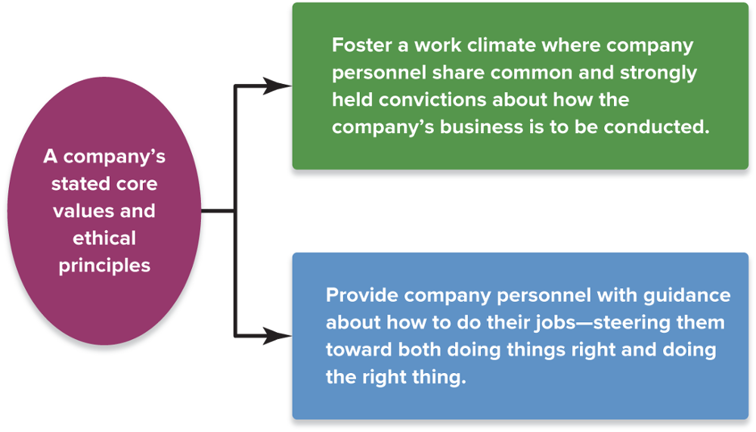
FIGURE 12.1 The Two Culture-Building Roles of a Company’s Core Values and Ethical Standards
Jump to Appendix 2 long image description

Slide 10
EMBEDDING CULTURAL NORMS IN THE ORGANIZATION AND PERPETUATING THE CULTURE (1 of 2)
Screen applicants and hire those who will mesh well with the culture
Incorporate discussions of the firm’s culture and its behavioral norms into orientation programs for new employees and training courses for managers and employees
Have senior executives frequently reiterate the importance and role of the firm’s values and ethical principles at the firm’s events and in internal communications to employees
Expect managers at all levels to be cultural role models and exhibit advocated cultural norms in their own behavior

Slide 11
EMBEDDING CULTURAL NORMS IN THE ORGANIZATION AND PERPETUATING THE CULTURE (2 of 2)
Make the display of cultural norms a factor in evaluating each person’s job performance, granting compensation increases, and deciding who to promote
Stress that line managers all the way down to first-level supervisors give ongoing attention to explaining the desired cultural traits and behaviors in their areas and clarifying why they are important
Encourage company personnel to exert strong peer pressure on co-workers to conform to expected cultural norms
Hold periodic ceremonies to honor people who excel in displaying the company values and ethical principles

Slide 12
Strategic Management Principle (2 of 5)
A company’s values statement and code of ethics communicate expectations of how employees should conduct themselves in the workplace.
To deeply ingrain the stated core values and high ethical standards, firms must turn them into strictly enforced cultural norms.

Slide 13
FORCES THAT CAUSE A FIRM’S CULTURE TO EVOLVE
New or revolutionary technologies
New challenges in the marketplace
Diversification into new businesses
Causes of Cultural Change
Shifting internal conditions
Rapid growth of the firm
Merger or acquisition of another firm
Jump to Appendix 3 long image description

Slide 14
STRONG VERSUS WEAK CULTURES
Strong-culture firm
Has deeply rooted widely-shared values, behavioral norms, and operating approaches
Insists that its values and principles be reflected in the decisions and actions taken by all company personnel
Weak-culture firm
Lacks values and principles that are consistently preached or widely shared
Has few or no traditions, beliefs, values, common bonds, or behavioral norms

Slide 15
Core Concept (2 of 3)
In a strong-culture company, deeply rooted values and norms of behavior are widely shared and regulate how it conducts its business.

Slide 16

DEVELOPMENT OF A STRONG CULTURE
Closely aligning corporate culture with the requirements for proficient strategy execution merits the full attention of senior executives.
Founder or strong leader with strong values
Commitment by the firm to ethical behavior
Strong Culture
Jump to Appendix 4 long image description

Slide 17
Strategic Management Principle (3 of 5)
A strong culture that encourages actions, behaviors, and work practices that are in sync with the chosen strategy and conducive to good strategy execution is a valuable ally in the strategy execution process.

Slide 18
WHY CORPORATE CULTURES MATTER TO THE STRATEGY EXECUTION PROCESS
A culture that is well matched to the chosen strategy and the requirements of the strategy execution effort focuses the attention of employees on what is most important to this effort.
Culture-induced peer pressure further induces personnel to do things in a manner that aids the cause of good strategy execution.
A culture that is consistent with the requirements for good strategy execution can energize employees, deepen their commitment to execute the strategy flawlessly, and enhance worker productivity.

Slide 19
Strategic Management Principle (4 of 5)
It is in management’s best interest to dedicate considerable effort to establishing a corporate culture that encourages behaviors and work practices conducive to good strategy execution.

Slide 20


HEALTHY CULTURES THAT AID GOOD STRATEGY EXECUTION
Performance
Good Strategy Execution
High-Performance Cultures
Adaptive Cultures
Commitment to achieving stretch objectives and accountability
Willingness to accept change and take on challenges
Jump to Appendix 5 long image description

Slide 21
Strategic Management Principle (5 of 5)
As a company’s strategy evolves, an adaptive culture is a definite ally in the strategy-implementing, strategy-executing processes as compared to cultures that are resistant to change.

Slide 22

UNHEALTHY CULTURES THAT IMPEDE GOOD STRATEGY EXECUTION
Incompatible Subcultures
Change-resistant cultures
Insular, inwardly focused cultures
Unhealthy Cultures
Politicized cultures
Unethical and greed-driven cultures
Poor Strategy Execution
Poor Performance
Jump to Appendix 6 long image description

Slide 23
CHANGING A PROBLEM CULTURE: THE ROLE OF LEADERSHIP
A strong, out of sync, or unhealthy culture must be changed in order to execute strategy successfully.
Competent leadership at the top is necessary for culture-change efforts to succeed.

Slide 24
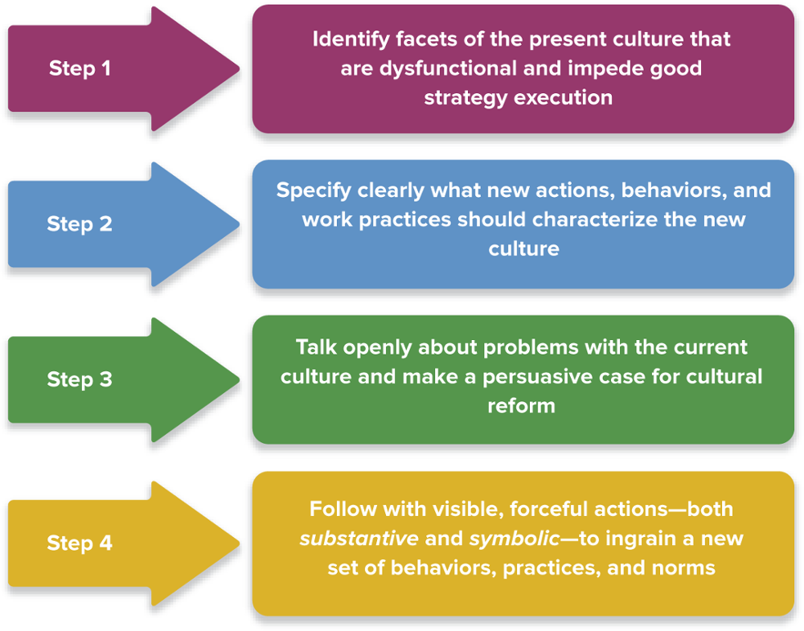
FIGURE 12.2 Changing a Problem Culture
Jump to Appendix 7 long image description

Slide 25
MAKING A COMPELLING CASE FOR CULTURE CHANGE
Selling the change
Explain why and how certain behavioral norms and work practices are obstacles to good execution of strategic initiatives
Explain how new behaviors and work practices will produce better results
If the need for cultural change is due to a change in strategy, cite reasons why the current strategy has to be modified

Slide 26
SUBSTANTIVE CULTURE-CHANGING ACTIONS
Replace key executives who are resisting or obstructing needed organizational and cultural changes
Promote individuals who support cultural shifts and can serve as role models for the cultural behavior
Appoint outsiders with the desired cultural attributes to high-profile positions
Screening all candidates for positions carefully, hiring only those who appear to fit in with the new culture
Mandate that all personnel attend culture-training
Design compensation incentives that boost the pay of teams and individuals who support culture change
Revise policies and procedures to drive cultural change

Slide 27
SYMBOLIC CULTURE-CHANGING ACTIONS
Changing the Culture of an Organization
Top executive and upper management behaviors
Ceremonial events to honor exemplary employees
Physical symbols that represent the new culture
Jump to Appendix 8 long image description

Slide 28
HOW LONG DOES IT TAKE TO CHANGE A PROBLEM CULTURE?
Changing a problem culture is never a short-term exercise.
A sustained and persistent effort to reinforce the culture at every opportunity through word and deed is required.
It takes time for a new culture to emerge and prevail; it takes even longer for it to become deeply embedded.
Fixing a problem culture and instilling a new set of attitudes and behaviors can take 2 to 5 years.

Slide 29
Culture Transformation at America Latina Logistica (ALL)
What steps did CEO Alexandre Behring take to begin ALL’s cultural transformation into a performance-oriented organization?
What symbolic steps did top managers take to demonstrate their commitment to the new culture and to reinforce the personnel and process changes they implemented?
Which actions are likely to cause the most pronounced cultural change in an organization?

Slide 30
LEADING THE STRATEGY EXECUTION PROCESS
Leading strategy execution requires:
Staying on top of what is happening and closely monitoring progress
Putting constructive pressure on the organization to execute the strategy well and achieve operating excellence
Initiating corrective actions to improve strategy execution and achieve the targeted performance results

Slide 31
STAYING ON TOP OF HOW THINGS ARE GOING
Management by Walking Around (MBWA):
Is used by leaders to stay informed about how well the strategy execution process is progressing
Involves spending time with people at company facilities, asking questions, listening to their opinions and concerns, and gathering firsthand information about how well aspects of the strategy execution process are going

Slide 32
Core Concept (3 of 3)
Management by walking around (MBWA) is one of the techniques that effective leaders use to stay informed about how well the strategy execution process is progressing.

Slide 33
MOBILIZING THE EFFORT FOR EXCELLENCE IN STRATEGY EXECUTION
Treat employees as valued partners
Foster an esprit de corps that energizes members
Use empowerment to create a fully engaged workforce
Set stretch objectives that require personnel to give their best in achieving performance targets
Use benchmarking, reengineering, TQM, and Six Sigma tools to focus attention on continuous improvement
Use motivational techniques and compensation incentives to inspire, nurture a results-oriented work climate, and enforce high standards
Celebrate individual, group, and company successes

Slide 34
LEADING THE PROCESS OF MAKING CORRECTIVE ADJUSTMENTS
Making Corrective Actions Successfully Requires
A thorough analysis of the situation
Good business judgment in deciding what actions to take
Good implementation of the corrective actions
Jump to Appendix 9 long image description

Slide 35
A FINAL WORD ON LEADING THE PROCESS OF CRAFTING AND EXECUTING STRATEGY
It is difficult to separate leading the process of executing strategy from leading the strategy process.
Crafting, implementing, and executing strategy is a continuous process that requires much adjusting and fine-tuning of the strategy to fit changing circumstances.
The tests of strategic leadership are whether the firm has a good strategy and business model, whether its strategy is competently executed, and whether the firm is achieving its performance targets.
If these three conditions exist, then the firm has good strategic leadership and is a well-managed enterprise.

Slide 36
Appendix 1 Identifying the Key Features of a Company’s Corporate Culture
Eight key features of a company's corporate culture are:
Values, principles, and ethical standards in actual use
Management practices and organizational policies
Atmosphere and spirit embodied in the firm's work climate
How managers and employees interact and relate to one another
Strength of peer pressure to conform and observe norms
Actions and behaviors encouraged and rewarded
Traditions and stories and "how we do things around here"
How the firm treats its stakeholders
Return to slide

Slide 37
Appendix 2 Figure 12.1 The Two Culture-Building Roles of a Company’s Core Values and Ethical Standards
A company's stated core values and ethical principles (1) foster a work climate where company personnel share common and strongly held convictions about how the company's business is to be conducted and (2) provide company personnel with guidance about how to do their jobs —steering them toward both doing things right and doing the right thing.
Return to slide

Slide 38
Appendix 3 Forces That Cause a Firm’s Culture to Evolve
Causes of cultural change can be new or revolutionary technologies, diversification into new businesses, rapid growth of the firm, a merger or acquisition of another firm, shifting internal conditions, and new challenges in the market place.
Return to slide

Slide 39
Appendix 4 Development of a Strong Culture
A strong culture is developed by a founder or strong leader with strong values, as well as commitment by the firm to ethical behavior.
Return to slide

Slide 40
Appendix 5 Healthy Cultures That Aid Good Strategy Execution
High-performance cultures have a commitment to achieving stretch objectives and accountability.
Adaptive cultures have a willingness to accept change and take on challenges.
Both contribute to good strategy execution and performance.
Return to slide

Slide 41
Appendix 6 Unhealthy Cultures That Impede Good Strategy Execution
Unhealthy cultures include politicized cultures; change-resistant cultures; incompatible subcultures; insular, inwardly focused cultures; unethical and greed-driven cultures. These types of cultures lead to poor strategy execution and poor performance.
Return to slide

Slide 42
Appendix 7 Figure 12.2 Changing a Problem Culture
Step 1: Identify facets of the present culture that are dysfunctional and impede good strategy execution.
Step 2: Specify clearly what new actions, behaviors, and work practices should characterize the new culture.
Step 3: Talk openly about problems with the current culture and make a persuasive case for cultural reform.
Step 4 : Follow with visible, forceful actions, both substantive and symbolic, to ingrain a new set of behaviors, practices, and norms.
Return to slide

Slide 43
Appendix 8 Symbolic Culture-Changing Actions
The culture of an organization can be changed by top executive and upper management behaviors, by ceremonial events to honor exemplary employees, and by physical symbols that represent the new culture.
Return to slide

Slide 44
Appendix 9 Leading the Process of Making Corrective Adjustments
Making corrective actions successfully requires a thorough analysis of the situation, good business judgment in deciding what actions to take, and good implementation of the corrective actions.
Return to slide

